Slide 1

Section 2. Practical tips for writing your applied paper
Style, tone, length and grammar

Slide 2
What type of journal are you targeting?
Economics and (for instance) medical journals have distinctive styles

Slide 3

Media attention and Vaccine Hesitancy: Examining the mediating effects of Fear of COVID-19 and the moderating role of Trust in leadership
Lulin Zhou,Sabina Ampon-Wireko , Xinglong Xu, Prince Edwudzie Quansah, and Ebenezer Larnyo
Published: February 18, 2022 https://doi.org/10.1371/journal.pone.0263610
The current study, therefore, hypothesized that; H1: Media attention has a significant influence on COVID-19 vaccine hesitancy. H2: Media attention significantly influences fear of COVID-19 positively.

Slide 4
I see manuscripts submitted to the Journal of Policy Analysis and Management (JPAM) with this type of phrasing all the time. I imagine that some policy journals publish papers that use this type of phrasing, but JPAM, as a general rule, does not.
Written in third person
The current study, therefore, hypothesized that; H1: Media attention has a significant influence on COVID-19 vaccine hesitancy. H2: Media attention significantly influences fear of COVID-19 positively.

Slide 5
I see manuscripts submitted to the Journal of Policy Analysis and Management (JPAM) with this type of phrasing all the time. I imagine that some policy journals publish papers that use this type of phrasing, but JPAM, as a general rule, does not.
The current study, therefore, hypothesized that; H1: Media attention has a significant influence on COVID-19 vaccine hesitancy. H2: Media attention significantly influences fear of COVID-19 positively.
Conflates statistical significance and importance

Slide 6
Style, Tone, Length and Grammar
What type of journal are you targeting?
Economics and (for instance) medical journals have distinctive styles
Let’s imagine that you’re targeting an economics journal
Within economics, journals have distinctive styles
Read a few articles in the journal that you’re targeting
Economics Letters, American Economic Review: Insights, AEA: Papers and Proceedings, have strict word count limits

Slide 7
Style, Tone, Length and Grammar
What type of journal are you targeting?
Economics and (for instance) medical journals have distinctive styles
Let’s imagine that you’re targeting a field journal such as the Journal of Health Economics, Labour Economics, or the Journal of Public Economics

Slide 8
Style and Tone
Engaging without being chatty or informal
More formal than the language you hear being used in seminars
Avoid “get” and “got”
Avoid using contractions (e.g., won’t, don’t, can’t, shouldn’t)
Avoid this construction:
Read what you wrote out loud
Does each sentence set up the next?
Does each paragraph set up the next?
Don’t reinvent the wheel
Read some classics. How did Charles and Guryan (2008) begin their introduction? What are they doing in their first paragraph? In their second paragraph?
“…we use for our main calibration the value 0.38, i.e. the median of the elasticity estimates in the literature.”
The language/style you use in a seminar is more informal! Don’t use exclamation points!

Slide 9
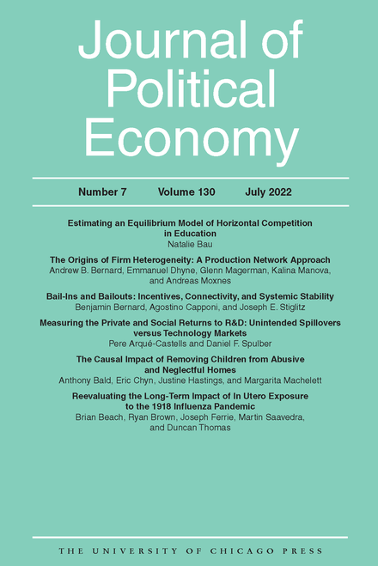
Introduction
Becker’s (1957) seminal The Economics of Discrimination launched the formal analysis of labor market discrimination among economists. Becker’s analysis focused on the relationship between racial prejudice among whites and discrimination against racial minorities in a competitive model. In contrast to much of the contemporaneous literature, Becker formalized the definition of racial preferences…

Slide 10
Introduction
Becker’s (1957) seminal The Economics of Discrimination launched the formal analysis of labor market discrimination among economists. Becker’s analysis focused on the relationship between racial prejudice among whites and discrimination against racial minorities in a competitive model. In contrast to much of the contemporaneous literature, Becker formalized the definition of racial preferences…
In the short-run version of Becker’s employer discrimination model,
racial prejudice causes some employers to regard black workers as more expensive than they truly are. Market pressures cause blacks to be hired by the least prejudiced employers in the market and to sort away from those with the highest levels of prejudice…Racial wage gaps…will generally be determined by variation in the level of prejudice of those in the lower tail of the prejudice distribution; how prejudiced the most prejudiced employers are should not matter at all for wages in Becker’s framework. Finally,…equilibrium wages for blacks should vary negatively with the number of blacks in the market…

Slide 11
Introduction
Background
Data Summary
Empirical Strategy
Results
Conclusion
I’d call this the “classic” way to structure an economics paper

Slide 12
Length
Aim for 18-23 pages of text, 5-6 figures and tables (combined total)
More figures than tables
Extra tables and figures can go in an appendix
The revision process is usually going to add text, tables, and figures
Thirty pages of text and 10 figures/tables is too much! Referees and editors have short attention spans.

Slide 13
Grammar
Pay someone to read you paper over for typos and grammatical errors
Make sure there is a one-to-one correspondence between in-text citations and references
Use a consistent style for the references.
Include the first names of the authors. The editor is looking at your references for potential referees.

Slide 14
Section 2. Practical tips for writing your applied paper:
Writing the first half of your paper

Slide 15



Writing the first half of your applied paper
The Introduction
Perhaps the most important part of your paper.
Why should someone keep reading your paper if they aren’t “hooked” by the end of the introduction?

Slide 16

The Introduction
When I sat down to write my first introduction, I felt overwhelmed. I did not know where to begin.
For my first paper, I surrounded myself by well-published papers with well-written introductions…
I quickly learned that there is a method to writing a good introduction.
Just like there is a template for a paper in its entirety, there is a template for the introduction.
Let’s break this thing down…

Slide 17
The Introduction
An introduction to an applied research paper should contain the following elements:
(i) A general motivation. Ideally, a motivation that captivates economists and non-economists alike.
(ii) A more specific motivation. For instance, a motivation that appeals to the very policy being analyzed or specific theory being tested.
(iii) A brief description of the most important background information or institutional details (save the rest for the background section of your paper)
(iv) A description of your data.
(v) A description of your identification strategy.
(vi) A description of your principal results.
(vii) A roadmap for the rest of your paper (optional)
I like to approach writing my introductions as a process of checking off the above boxes.
Let’s walk through an example…
-You are NOT writing a mystery novel!
-Your reader should know exactly what to expect by the end of the introduction.

Slide 18

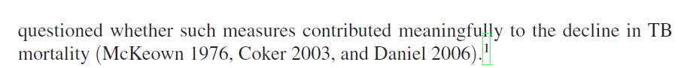
(i) A general motivation that appeals to a broad audience.
(ii) A more specific motivation that appeals to scholars working in this area.
Previous explanations for the TB mortality decline are listed
Highlight the explanation we are interested in testing (i.e., the introduction of public health measures)
Highlight that this remains an open question, which also highlights our scientific contribution

Slide 19
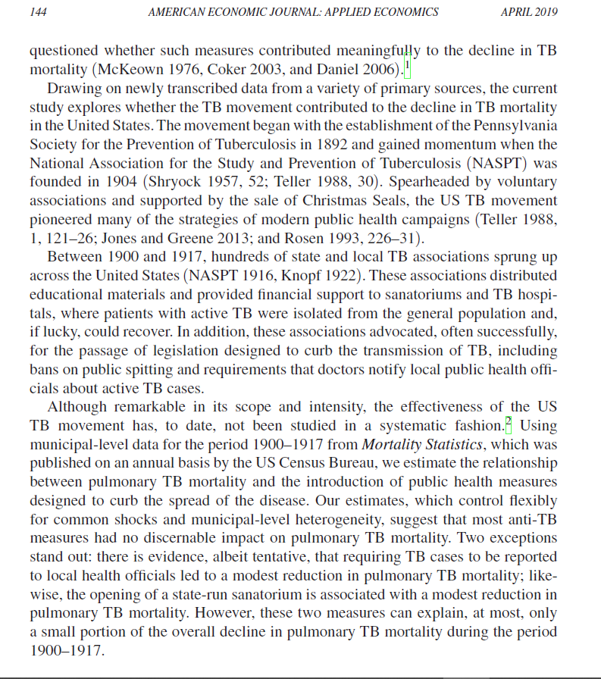
(iii) Important background details
Historical background
Relevance to modern day public health
What constituted the anti-TB campaign?
(iv) Data description
(v) Identification
(vi) Results

Slide 20
The Introduction: Two Common FAQs
How many contributions should I list?
Don’t get carried away here. A good paper probably only makes one or two real contributions.
If you feel that your paper really does make more than this, clearly highlight what you think is the most important of the listed contributions.
Big mistake is to list a bunch of contributions that are not ranked in order of importance and claim to advance a number of different fields.
This can send the signal that you really aren’t sure where your major contributions lie.
Is my paper a labor paper or a behavioral paper or a econ history paper…or wait, is it something else? Try to avoid creating this confusion (especially for editors who are trying to figure out the appropriate referees for your manuscript).
How long should my introduction be?
Clearly, there is no rule of thumb.
But, avoid lumping your intro and background sections into one big introduction.
Erroring on the side of brevity is probably better. Do not ask the reader to wade through a 10-page introduction.
The last 15 papers I have written as full-length articles for economics journals have had introductions of the following lengths (size 12 font, double-spaced):
1-2 pages | 2-3 pages | 3-4 pages | 4-5 pages | 5+ pages
3 papers | 6 papers | 3 papers | 3 papers | 0 papers!!!

Slide 21
Background
Break into subsections (not necessarily in this order):
(i) Background/historical/institutional details regarding your right-hand side variable of interest
Include information in this section that may be important for your identification strategy
For instance, how many policy changes do you observe? For how many units (e.g., cities, counties, states, etc.) do you observe pre- and post-treatment data?
(ii) Background on your specific relationship of interest
(iii) Background specific to the theory you are testing (if any)
(iv) Literature review can be a separate section or woven into the above sections.
As I have become more comfortable with writing background sections, I like to cite the relevant literature within sections (i)-(iii). Generally flows better.
As a matter of style, one should include subsection headers for each of these background components. This helps to quickly orient a reader who may be going back and forth between sections of your manuscript.

Slide 22
Example 1. “The Effects of Pretrial Detention on Conviction, Future Crime, and Employment: Evidence from Randomly Assigned Judges” (Dobbie et al. 2018, American Economic Review)
Goal of paper: Use detention tendencies of quasi-randomly assigned bail judges to estimate the causal effects of pretrial detention on subsequent defendant outcomes.
Background, Section A. Overview of the bail system in the United States
Very general overview providing reader with how the bail system works in the United States
Background, Section B. Description of the setting specific to their data (i.e., Philadelphia and Miami-Dade Counties)
Broken into 3 subsections: (i) One on the bail system in Philadelphia County; (ii) one on the bail system in Miami-Dade County; (iii) and one describing how the features of the Philadelphia and Miami-Dade bail systems make them an appropriate setting for their research design.
I really like their subsection B. (iii). Great example of how one can describe the intuition behind their identification strategy before you get to any regression equations. I highly recommend reading this part of their paper.

Slide 23
Example 2. “Personal Belief Exemptions for School-Entry Vaccinations, Vaccination Rates, and Academic Achievement” (Hair et al. 2018, Journal of Health Economics)
Goal of paper: Examine how state-level nonmedical exemptions from school-entry vaccine mandates affect vaccination rates in early childhood and academic achievement in middle school.
Nice example of a straightforward (and well-written) paper that does not require a lengthy background section.
Background, Section 1. Description of policy changes in their treated states (i.e., Texas and Arkansas).
Background, Section 2. Discussion of how exemptions might affect a downstream outcome such as academic achievement.
The authors list and describe the possible mechanisms.
Great example of a discussion on mechanisms that comes before results are presented.

Slide 24
Example 3. “Safeguarding Consumers Through Minimum Quality Standards: Milk Inspections and Urban Mortality, 1880-1910” (Anderson et al. 2022, NBER Working Paper No. 30063)
Goal of paper: Estimate the effect of municipal-level milk inspections on infant and waterborne mortality.
Background, Section 1. The general history of municipal milk inspections in the United States.
Describe exactly how inspections worked in practice.
Background, Section 2. History of other municipal-level efforts to provide pure milk.
Give readers a sense of what other public health policies and efforts were being mandated.
Relevant for the empirical strategy. What are the omitted variables we be concerned about?
Background, Section 3. Literature review on minimum quality standards (MQSs) and their effects.
Review the competing empirical literature and describe the theoretical contributions
I’ve listed this paper for this specific subsection. Of the 3 examples, this paper tests a classic economic theory, whereas the others do not. As a result, the literature review must tackle both empirical and theoretical studies.

Slide 25
Background: A common mistake!
In one’s literature review, not all previous studies should be treated equally.
Researchers should provide careful and accurate evaluations of previous studies.
Most policymakers have never heard of fixed effects, have no idea what a regression discontinuity is, and do not care whether state-specific time trends were included on the right-hand side.
Policymakers and non-economists count on us to communicate which studies should be taken seriously and which should not (or be ignored).
For instance, giving studies that rely on cross-sectional policy variation the same weight as those that rely on within-state policy variation comes with the risk of leading policymakers astray.
For example, researchers interested in the relationship between marijuana use and alcohol consumption all too often declare that the literature is “mixed”, citing Pacula (1998a) and Williams et al. (2004) as evidence of complementarity and Kelly and Resul (2014) and Sabia et al. (2017) as evidence of substitutability.
This is a LAZY characterization of the literature.
Pacula (1998a) and Williams et al. (2004) relied on cross-sectional policy variation. Their estimates could simply reflect unobserved factors at the state level such as preferences and attitudes.
On the other hand, Kelly and Resul (2014) and Sabia et al. (2017) used panel data and exploited well-defined natural experiments…much more credible research design!

Slide 26
Data and empirical strategy
Two separate sections or just one?
Both ways are common within the greater applied economics literature.
More and more, I prefer combining these two components into one section.
Every now and then you see someone describe their empirical strategy before their data.
I’m not a huge fan of this.
As a reader, I want to understand the data set before I start thinking about the empirical strategy in detail
The ordering I have settled on goes something like the following:
First, begin by describing your outcome data.
Second, describe your primary estimating equation.
Lastly, describe the data for your right-hand side variables.
This can best be illustrated through another example. Let’s go back to the milk inspections paper (Anderson et al. 2022, NBER Working Paper No. 30063)…

Slide 27
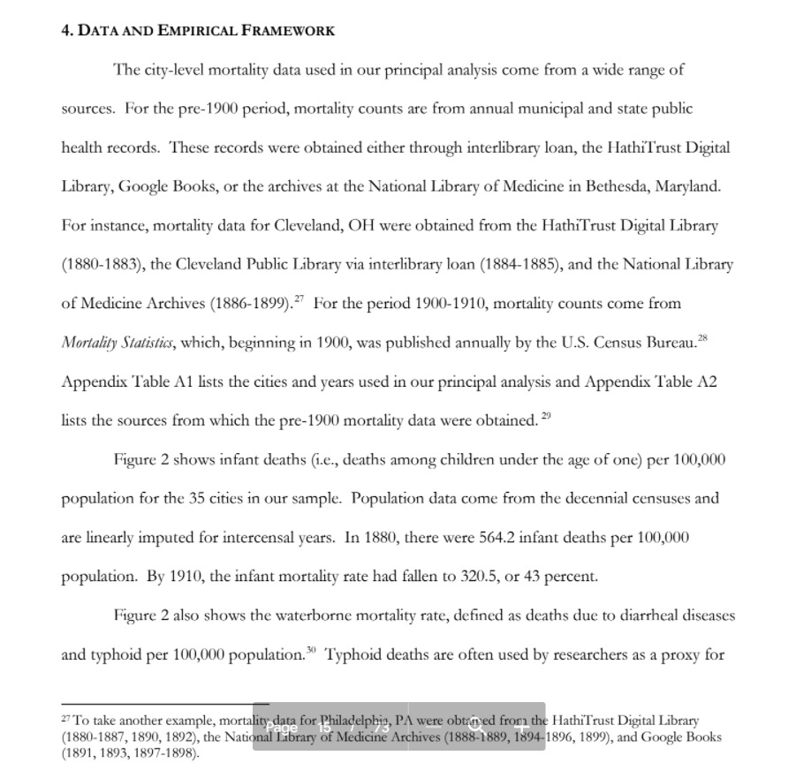
First, we describe the data sources for our outcomes of interest (i.e., mortality rates).
If you spent considerable time and effort collecting a unique data set, make sure to play that up! Make sure you get credit for impressive data efforts.
Describe your data in a manner that also sheds light on where identification is coming from. It should never be a black box (App. Table A1).
List your sources in detail. Make sure the reader knows exactly where and how you obtained your data (App. Table A2).
This is also a great place to show descriptive figures, such as trends in your outcomes (Figure 2)
This spices things up a bit.
Rather than just a boring description of the data, spend some time highlighting interesting trends, differences in means between groups, etc.

Slide 28
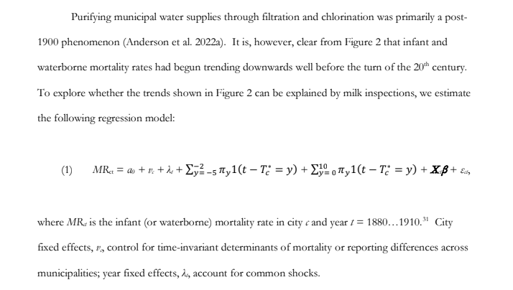
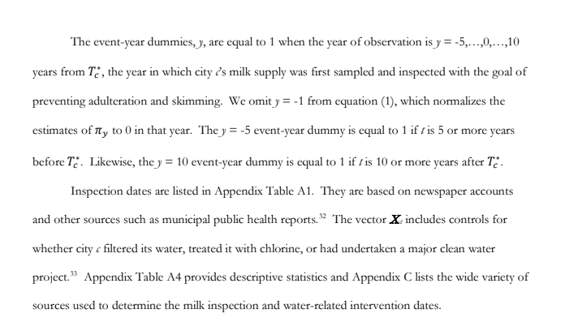
Next, describe your estimating equation.
If you can, try to use your descriptive figures/statistics as motivation for your regression equation.
Don’t screw up your subscripts!!! This happens way too often in papers submitted for review.
Finally, use your regression equation as a jumping off point to discuss the variables on the right-hand side.
Start with describing your primary right-hand side variable of interest.
After that, discuss the other Xs.
For these other controls, I like to list their sources and other pertinent information in footnotes. As we have done here.
Often, these Xs are not all that important. Presenting these variables in this manner allows the reader to decide for herself if she wants the source information.
If she does, she can read the footnote. If not, she can skip it.
It is common for researchers to go on and on describing the controls in X in a data section before the discussion of the empirical strategy.
I do not recommend this.
Putting this information in the main text can disrupt the flow of the manuscript, especially for the reader who wants to gloss over this information.

Slide 29
Q&A (≈ 10 minutes) + Break (≈ 5 minutes)

Slide 30
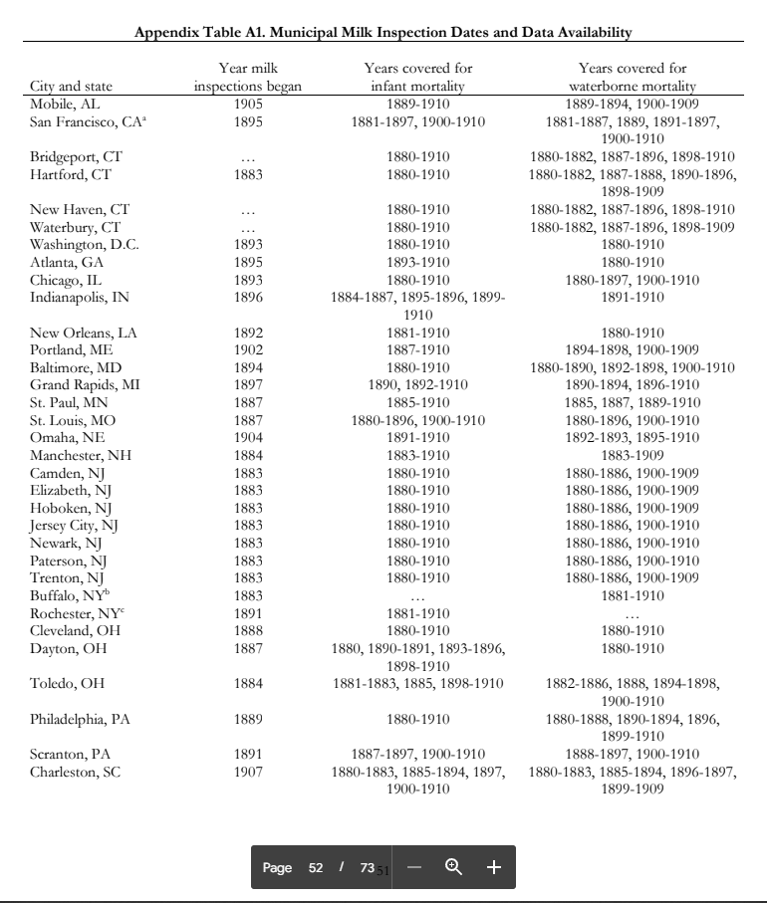
back

Slide 31
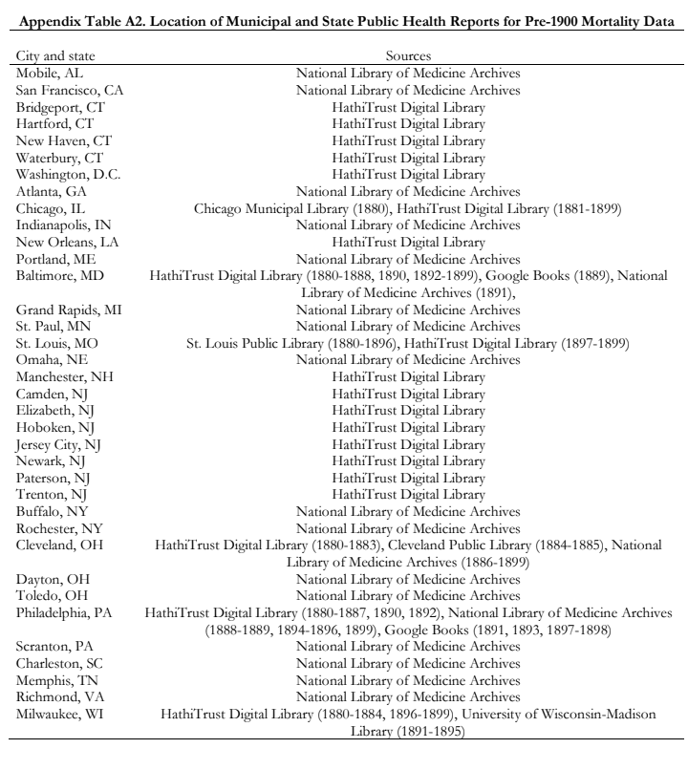
back

Slide 32
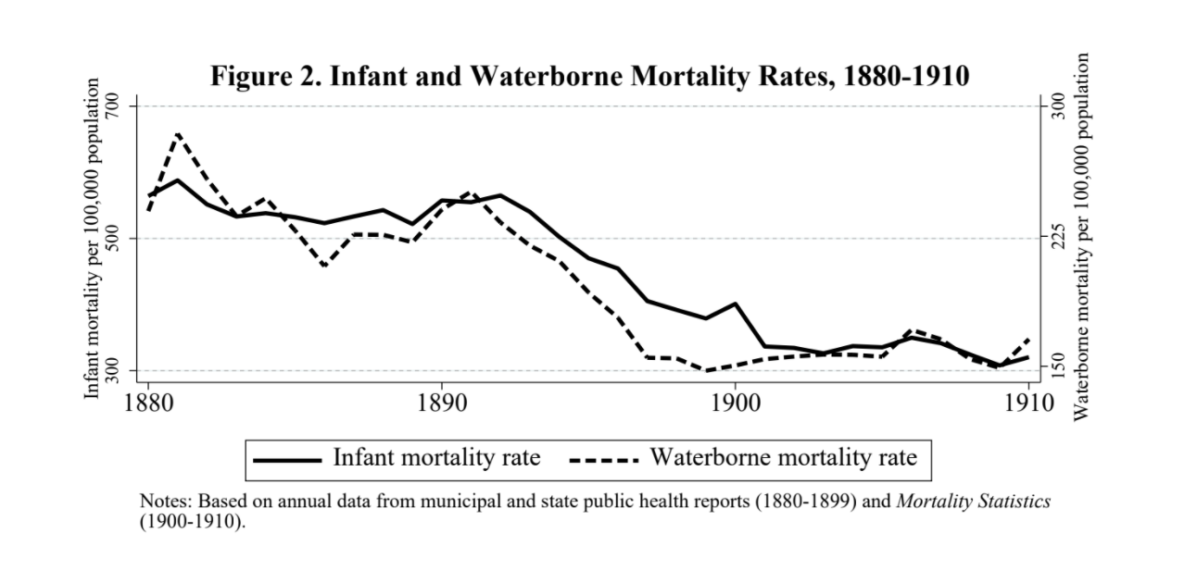
back

Slide 33
Section 2. Practical tips for writing your applied paper:
Producing Effective Tables
Useful Phrases When Describing Regression Results
Thinking about Statistical Significance and Magnitude
Data Mining

Slide 34
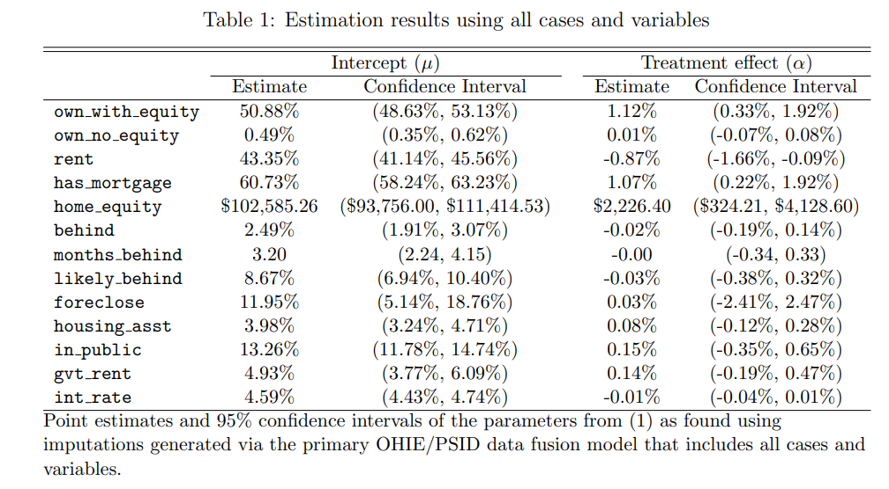
This table is from a submission to a top field journal. What can be improved?

Slide 35
The title could be much more informative. Must read the paper to understand what the authors are doing.
Variable names are directly from Stata program

Slide 36
In general, the table is too cluttered. There is too much going on...
Measure in 1000s of $s
What is the treatment? Use the notes to provide some sense of what is being estimated and how.

Slide 37
Period here instead of colon
Table 1. Years of schooling and hourly wages: Sample restricted to Danish respondents
 | Men Women wages ln(wages) wages ln(wages)
Schooling | 5.64 .054* (5.11) (.030) | 7.83** .094*** (3.55) (.007)
Observations | 12,385 | 12,012
Notes: The sample is restricted to CHAT respondents ages 25-45 from Colorado, Nebraska, and Iowa whose wage was greater than or equal to $3.25 per hour. Each column reports an estimate from a separate OLS regression of wages on years of schooling. Controls include race, ethnicity, marital status, union status, years of experience, tenure at current job, and firm size. Standard errors clustered at the state level are reported in parentheses. * Statistically significant at the 10% level; ** at the 5% level; *** at the 1% level.
Now you can use a colon here

Slide 38
Don’t report too many digits past the decimal point—it gives the impression that your estimates are precise to the n^{th} digit past the decimal point
Table 1. Estimates of the relationship between years of schooling and hourly wages
 | Men Women wages ln(wages) wages ln(wages)
Schooling | 5.64 .054* (5.11) (.030) | 7.83** .094*** (3.55) (.007)
Observations | 12,385 | 12,012
Notes: The sample is restricted to CHAT respondents ages 25-45 from Colorado, Nebraska, and Iowa whose wage was greater than or equal to $3.25 per hour. Each column reports an estimate from a separate OLS regression of wages on years of schooling. Controls include race, ethnicity, marital status, union status, years of experience, tenure at current job, and firm size. Standard errors clustered at the state level are reported in parentheses. * Statistically significant at the 10% level; ** at the 5% level; *** at the 1% level.
Always tell readers if you’re reporting t-statistics or SEs under the estimated coefficients

Slide 39
Keep the table uncluttered. Don’t report the estimated coefficients of the controls.
Table 1. Estimates of the relationship between years of schooling and hourly wages
 | Males Femalesª wages ln(wages) wages ln(wages)
Schooling | 5.64 .054* (5.11) (.030) | 7.83** .094*** (3.55) (.007)
Observations | 12,385 | 12,012
State Fixed Effects Yes Yes State-Specific Trends Yes Yes
Notes: The sample is restricted to CHAT respondents ages 25-45 from Colorado, Nebraska, and Iowa whose wage was greater than or equal to $3.25 per hour. Each column reports an estimate from a separate OLS regression of wages on years of schooling. Controls include race, ethnicity, marital status, union status, years of experience, tenure at current job, and firm size. Standard errors clustered at the state level are reported in parentheses. * Statistically significant at the 10% level; ** at the 5% level; *** at the 1% level. ª Female respondents under the age of 30 were excluded from the analysis.
You can provide additional information in the notes to the tables or under the estimates.

Slide 40
Table 1. Estimates of the relationship between years of schooling and hourly wages
 | Males Females wages ln(wages) wages ln(wages)
Schooling | 5.64 .054* (5.11) (.030) | 7.83** .094*** (3.55) (.007)
Observations | 12,385 | 12,012
Notes: The sample is restricted to CHAT respondents ages 25-45 from Colorado, Nebraska, and Iowa whose wage was greater than or equal to $3.25 per hour. Each column reports an estimate from a separate OLS regression of wages on years of schooling. Controls include race, ethnicity, marital status, union status, years of experience, tenure at current job, and firm size. Standard errors clustered at the state level are reported in parentheses. * Statistically significant at the 10% level; ** at the 5% level; *** at the 1% level.
Ideally, you provide enough information in the table so that the reader can interpret the estimates without having to read the text.

Slide 41
Useful Phrases When Describing Regression Results
I find evidence of a negative relationship between years of schooling and earnings.
The results suggest that schooling is negatively related to earnings.
Consistent with the hypothesis that educational attainment affects earnings, I find that...
A one-year increase in schooling is associated with a 6.8 percent increase in earnings.
The estimate of β is .068, suggesting that an additional year of schooling leads to a 6.8 percent increase in earnings.
The estimated effect of an additional year of schooling on earnings is positive 6.8 percent.

Slide 42
Common Pitfalls When Describing Regression Results
Don’t focus on statistical significance
Do your best to characterize magnitude
Be clear about the units
Don’t confuse “percent” and “percentage”

Slide 43
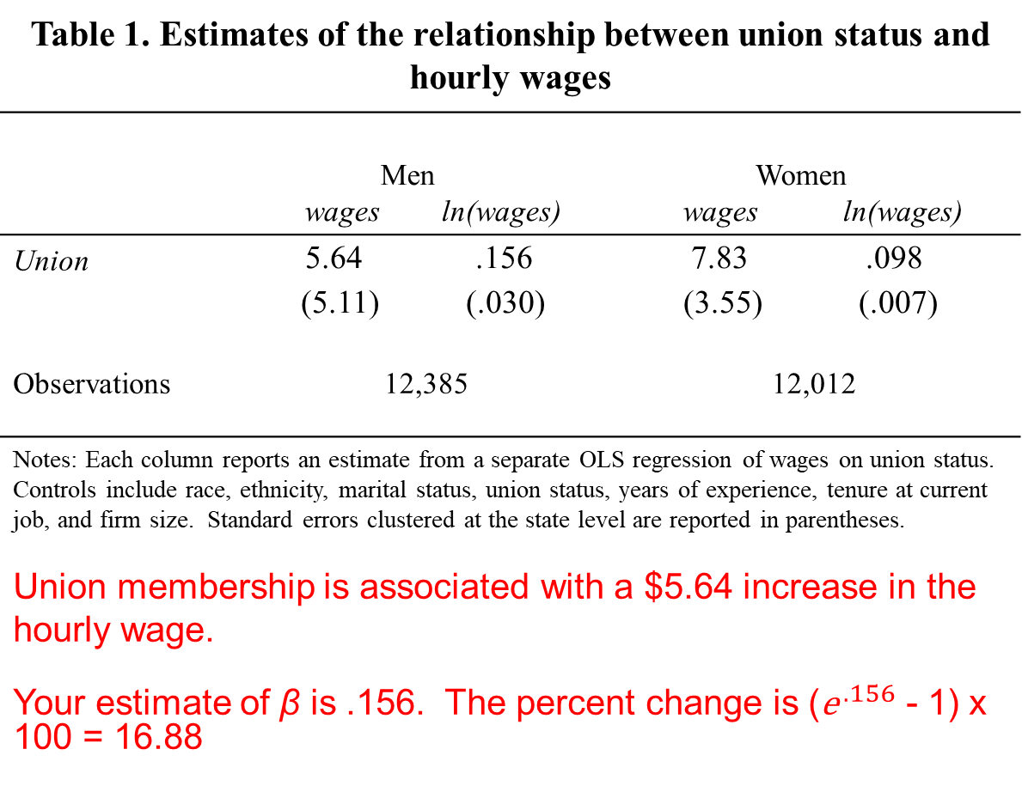
Table 1. Estimates of the relationship between union status and hourly wages
 | Men Women wages ln(wages) wages ln(wages)
Union | 5.64 .156 (5.11) (.030) | 7.83 .098 (3.55) (.007)
Observations | 12,385 | 12,012
Notes: Each column reports an estimate from a separate OLS regression of wages on union status. Controls include race, ethnicity, marital status, union status, years of experience, tenure at current job, and firm size. Standard errors clustered at the state level are reported in parentheses. Union membership is associated with a $5.64 increase in the hourly wage. Your estimate of β is .156. The percent change is (${\text{e}}^{ .156}$ - 1) x 100 = 16.88

Slide 44
Table 1. Estimates of the relationship between years of schooling and the probability of being vaccinated
 | Vaccinated Vaccinated
Years of schooling | .111 (.030) | .021 (.007)
State FEs Mean of the DV Observations | no .266 12,385 | yes .266 12,012
Notes: The sample is restricted to CHAT respondents ages 25-45 from Colorado, Nebraska, and Iowa whose wage was greater than or equal to $3.25 per hour. Each column reports an estimate from a separate OLS regression of vaccination status (0/1) on years of schooling. Controls include race, ethnicity, marital status, union status, years of experience, tenure at current job, and firm size. Standard errors clustered at the state level are reported in parentheses.
An additional year of schooling is associated with a .021 increase in the probability of being vaccinated (with the state fixed effects)

Slide 45
Table 1. Estimates of the relationship between years of schooling and the probability of being vaccinated
 | Vaccinated Vaccinated
Years of schooling | .111 (.030) | .021 (.007)
State FEs Mean of the DV Observations | no .266 12,385 | yes .266 12,012
Notes: The sample is restricted to CHAT respondents ages 25-45 from Colorado, Nebraska, and Iowa whose wage was greater than or equal to $3.25 per hour. Each column reports an estimate from a separate OLS regression of vaccination status (0/1) on years of schooling. Controls include race, ethnicity, marital status, union status, years of experience, tenure at current job, and firm size. Standard errors clustered at the state level are reported in parentheses.
An additional year of schooling is associated with a 2.1 percentage point increase in the likelihood of being vaccinated (with the state fixed effects)

Slide 46
Table 1. Estimates of the relationship between years of schooling and the probability of being vaccinated
 | Vaccinated Vaccinated
Years of schooling | .111 (.030) | .021 (.007)
State FEs Mean of the DV Observations | no .266 12,385 | yes .266 12,012
Notes: The sample is restricted to CHAT respondents ages 25-45 from Colorado, Nebraska, and Iowa whose wage was greater than or equal to $3.25 per hour. Each column reports an estimate from a separate OLS regression of vaccination status (0/1) on years of schooling. Controls include race, ethnicity, marital status, union status, years of experience, tenure at current job, and firm size. Standard errors clustered at the state level are reported in parentheses.
Try to include mean of the DV when you can
An additional year of schooling is associated with a 2.1 percentage point increase in the likelihood of being vaccinated, or an 8 percent increase relative to the sample mean (.021/.266 = .079)

Slide 47
Table 1. Estimates of the relationship between the unemployment rate and the probability of being vaccinated
 | Vaccinated Vaccinated
Unemployment rate | .00005 (.0006) | .005 (.002)
State FEs Mean of the DV Observations | no .266 12,385 | yes .266 12,012
Notes: Each column reports an estimate from a separate OLS regression of vaccination status (0/1) on years of schooling . Controls include race, ethnicity, marital status, union status, years of experience, tenure at current job, and firm size. Standard errors clustered at the state level are reported in parentheses.
Don’t report “0.000”
An a one percentage point increase in the unemployment rate is associated with a .005 increase in the probability of being vaccinated (with the state fixed effects).
If the unemployment rate goes from 10.1 to 11.1 percent, that is a one percentage point increase in the unemployment rate.

Slide 48
Stargazing
Estimates of the relationship between years of schooling and hourly wages
 | Males Females wages ln(wages) wages ln(wages)
Schooling | 5.64 .054* (5.11) (.030) | 7.83** .094*** (3.55) (.007)
Observations | 12,385 | 12,012
Notes: The sample is restricted to CHAT respondents ages 25-45 from Colorado, Nebraska, and Iowa whose wage was greater than or equal to $3.25 per hour. Each column reports an estimate from a separate OLS regression of wages on years of schooling. Controls include race, ethnicity, marital status, union status, years of experience, tenure at current job, and firm size. Standard errors clustered at the state level are reported in parentheses. * Statistically significant at the 10% level; ** at the 5% level; *** at the 1% level.

Slide 50
The problem, and our main point, is that a difference can be permanent…without being "significant" in other senses, such as for science or policy. And a difference can be significant for science or policy and yet be insignificant statistically, ignored by the less thoughtful researchers.
--McCloskey and Ziliak (1996, p. 97)
We here examine the alarming hypothesis that ordinary usage in economics takes statistical significance to be the same as economic significance.
--McCloskey and Ziliak (1996, p. 98)
Statistical computing software routinely provide t-statistics for every estimated coefficient. But that programs provide it does not mean that the information is relevant for science. We suspect that referees enforce the proliferation of meaningless t- and F-statistics, out of the belief that statistical and substantive significance are the same.
--McCloskey and Ziliak (1996, p. 102)

Slide 51
The elementary point that "[t]here is no sharp border between 'significant' and 'insignificant,' only increasingly strong evidence as the P-value decreases" (David S. Moore and George P. McCabe 1993, p. 473) is not found in most of the earlier books from which most economists learned statistics and econometrics. The old classic by W. Allen Wallis and Harry V. Roberts, Statistics: A New Approach, first published in 1956, is an exception:
It is essential not to confuse the statistical usage of "significant" with the everyday usage. In everyday usage, "significant" means "of practical importance," or simply "important." In statistical usage, "significant" means "signifying a characteristic of the population from which the sample is drawn," regardless of whether the characteristic is important. (Wallis and Roberts [1956] 1965, p. 385

Slide 52
Magnitude and Significance
OLS estimates of the relationship between years of schooling and ln(wages) Insignificant Significant
.15 (.131) | .15 (.033)
.0012 (.003) | .0012 (.00001)
Note: Standard errors are reported in parentheses.
BIG
Small

Slide 53
OLS estimates of the relationship between years of schooling and ln(wages) Insignificant Significant
.15 (.131) | .15 (.033)
.0012 (.0033) | .0012 (.00001)
Note: Standard errors are reported in parentheses.
BIG
Small
Why would we characterize these estimates as “BIG”? Big relative to what?

Slide 54
OLS estimates of the relationship between years of schooling and ln(wages) Insignificant Significant
.15 (.131) | .15 (.033)
.0012 (.0033) | .0012 (.00001)
Note: Standard errors are reported in parentheses.
BIG
Small
Why would we characterize these estimates as “BIG”? Big relative to what?
1. Relative to previous estimates of the effect of schooling on wages…Cite the most important studies in this area (e.g., Angrist and Krueger 1991) or refer to a “stylized fact”.

Slide 55

Stylized fact
From Wikipedia, the free encyclopedia
(Redirected from Stylized facts)
Jump to: navigation, search
In social sciences, especially economics, a stylized fact is a simplified presentation of an empirical finding.^{[1]} A stylized fact is often a broad generalization that summarizes some complicated statistical calculations, which although essentially true may have inaccuracies in the detail.

Slide 56
OLS estimates of the relationship between years of schooling and ln(wages) Insignificant Significant
.15 (.131) | .15 (.033)
.0012 (.0033) | .0012 (.00001)
Note: Standard errors are reported in parentheses.
BIG
Small
Why would we characterize these estimates as “BIG”? Big relative to what?
2. Relative to the effect of other policies or to an established benchmark/goal. For instance, you could note that, according to your estimate, an additional year of schooling for Blacks would reduce the Black-White wage gap by 4 percentage points.

Slide 57
OLS estimates of the relationship between years of schooling and ln(wages) Insignificant Significant
.15 (.131) | .15 (.033)
.0012 (.0033) | .0012 (.00001)
Note: Standard errors are reported in parentheses.
BIG
Small
Why would we characterize these estimates as “BIG”? Big relative to what?
3. Relative to the mean wage in your sample, or to the change in wages from 1970 to 2015. You’re looking for some way of anchoring the estimate and putting its magnitude into context...

Slide 58
OLS estimates of the relationship between years of schooling and ln(wages) Insignificant Significant
.15 (.131) | .15 (.033)
.0012 (.0033) | .0012 (.00001)
Note: Standard errors are reported in parentheses.
BIG
Small
Why would we characterize these estimates as “small”? Small relative to what?
The above strategies still apply. Often a good idea to point reader to the upper bound of the 95% CI. Even the upper bound of the 95% CI is small relative to…

Slide 59
Sometimes you just want to confirm that your estimates are reasonable…
Using data on 19- through 22-year-olds and an RD design, Carpenter and Dobkin (2009) found that reaching the minimum legal drinking age was associated with a 21% increase in alcohol consumption and a 15% increase in traffic fatalities
The implied elasticity from these estimates is 0.71 (i.e., 0.15/0.21)
Restricting our sample to 19- through 22-year-olds, we (Anderson et al. 2013) found that legalizing medical marijuana was associated with a 15% decrease in alcohol consumption and a 12% decrease in traffic fatalities
The implied elasticity from these estimates is 0.80 (i.e., 0.12/0.15)
References
Anderson, D. Mark, Benjamin Hansen, and Daniel I. Rees. 2013. “Medical Marijuana Laws, Traffic Fatalities, and Alcohol Consumption.” Journal of Law and Economics, 56 (2): 333-369.
Carpenter, Christopher and Carlos Dobkin. 2009. “The Effect of Alcohol Consumption on Mortality: Regression Discontinuity Evidence from the Minimum Drinking Age.” AEJ: Applied, 1(1): 164-182.

Slide 60
Data Mining
Much of this lecture is based on Angrist and Pischke (2010). It also refers to Ehrlich (1975, 1977), Leamer (1983), and other researchers.
References
Angrist, Joshua D. and Jorn-Steffen Pischke. 2010. “The Credibility Revolution in Empirical Economics: How Better Research Design Is Taking the Con out of Econometrics.” Journal of Economic Perspectives, Vol. 24(2), pp. 3-30.
Donohue, John and Justin Wolfers. 2005. “Uses and Abuses of Statistical Evidence in the Death Penalty Debate”, Stanford Law Review, Vol. 58, pp. 787-
Donohue, John and Justin J. Wolfers. 2006. “The Death Penalty: No Evidence For Deterrence.” The Economists' Voice, Vol. 3 (5), Article 3.
Ehrlich, Isaac. 1975. “The Deterrent Effect of Capital Punishment: A Question of Life and Death.” The American Economic Review, Vol. 65 (3), pp. 397-417.
Ehrlich, Isaac. 1977. “Capital Punishment and Deterrence: Some Further Thoughts and Additional Evidence.” Journal of Political Economy, Vol. 85 (4), pp. 741-788
Leamer, Edward E. 1983. “Let's Take the Con Out of Econometrics.” The American Economic Review, Vol. 73 (1), pp. 31-43.
Mocan, H. Naci and R. Kaj Gittings. 2003. “Getting Off Death Row: Commuted Sentences and the Deterrent Effect of Capital Punishment”, Journal of Law and Economics, Vol. 46(2), pp. 453-478.

Slide 61

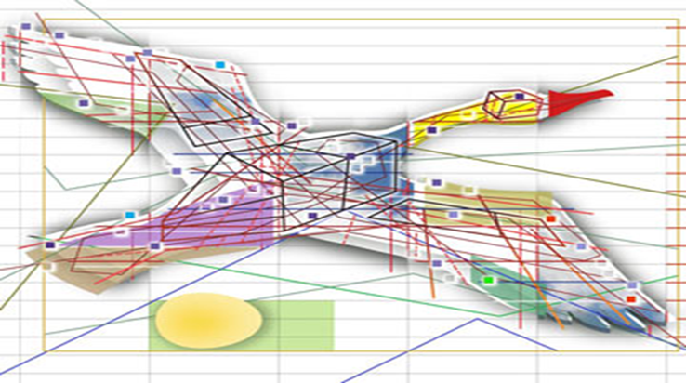
Data Mining
If you torture the data long enough, nature will confess.
--Ronald Coase
This is a sad and decidedly unscientific state of affairs we find ourselves in. Hardly anyone takes data analyses seriously. Or perhaps more accurately, hardly anyone takes anyone else's data analyses seriously. Like elaborately plumed birds who have long since lost the ability to procreate but not the desire, we preen and strut and display our t-values.
--Edward Leamer (1983, p. 37)

Slide 62

“Classic” data mining or p-hacking
The terminology “data mining” is often used in the context of pre-test bias. In particular, researchers often run a large number of different regressions on a body of data looking for significant t statistics (at ,say, the 5% level). Using this approach invalidates traditional hypothesis-testing procedures because such data mining is likely by chance to uncover significant t statistics; i.e., the final results chosen are much more likely to embody Type I error than the claimed 5%.
--From Peter Kennedy’s Guide to Econometrics (4th edtion)

Slide 63
Three signs you may be data mining
1. You only report estimates of the following equation:
y_{it} = α + β₁X_{1it} + β₂X_{2it} +… β_{k}X_{kit} + ε_{it} .
However, estimating this equation produces very different results:
ln(y_{it})= α + β₁X_{1it} + β₂X_{2it} +… β_{k}X_{kit} + ε_{it} .

Slide 64
2. You only report estimates of the following equation:
y_{it} = α₀ + α₁Z_{it-1} + β₁X_{1it} + β₂X_{2it} +… β_{k}X_{kit} + ε_{it} .
However, estimating any of these equations produces very different
results:
y_{it} = α₀ + α₁Z_{it} + β₁X_{1it} + β₂X_{2it} +… β_{k}X_{kit} + ε_{it}
y_{it} = α₀ + α₁Z_{it-2} + β₁X_{1it} + β₂X_{2it} +… β_{k}X_{kit} + ε_{it}
y_{it} = α₀ + α₁Z_{it-1}+ α₂Z_{it-2} + β₁X_{1it} +β₂X_{2it} +… β_{k}X_{kit} + ε_{it}
y_{it} = α₀ + α₁Z_{it} + α₂Z_{it-1}+ α₃Z_{it-2} + β₁X_{1it} +β₂X_{2it} +… β_{k}X_{kit} + ε_{it} .

Slide 65
3. You only report estimates of the following equation for respondents
ages 12-15:
y_{it} = α₀ + α₁Z_{it-1} + β₁X_{1it} + β₂X_{2it} +… β_{k}X_{kit} + ε_{it} .
However, you get very different results if your sample includes
16-year-olds.
A few more behaviors that can be described as data mining:
Stop project because of null results
Decide against submitting to a journal
Modifying your original hypothesis to better match results

Slide 66
Data mining is not the same thing as doing robustness checks
Table 5. Robustness Checks
 | Analgesics | Hallucinogens
1) Any disorder (baseline) | 0.039** (0.0161) | 0.0217** (0.0092)
2) Mild disorder | 0.0162 (0.0137) | 0.0106** (0.0051)
3) Moderate disorder | 0.0095 (0.0059) | 0.0033 (0.0043)
4) Severe disorder | 0.0122** (0.006) | 0.0086*** (0.0023)
5) Any disorder, no imputed outcomes | 0.0390** (0.0168) | 0.0220** (0.0093)
6) Any disorder, conditional on past year use | 0.8232** (0.3548) | 0.5748* (0.3056)
7) Any disorder, linear probability model | 0.0386** (0.0170) | 0.0202** (0.0095)
8) Any disorder, probit | 0.0391** (0.0161) | 0.0184** (0.0078)
9) Any disorder, economic conditions measured by employment rate | -0.0120 (0.0150) | -0.0172** (0.0080)
10) Any disorder, economic conditions measured by log GDP per capita | -0.00882* (0.00504) | -0.00232 (0.00156)
11) Any disorder, control for lagged unemployment | 0.0385** (0.0163) | 0.0214** (0.0090)

Slide 67
Among non-economists, data mining is not a dirty secret.

Slide 68
Capital Punishment: A Cautionary Tale
Note that, in theory, the relationship between capital punishment and violent crime could be negative. On the other hand, would-be criminals could be completely oblivious to the potential consequences of their actions.
Ehrlich (1975, 1977) estimated the relationship between violent crime and executions. He concluded that capital punishment acted as a deterrent. Specifically, he wrote, “[c]ontrary to strong inferences of many death-penalty researchers who interpreted their evidence as a categorical denial of the deterrence hypothesis, this study as well as a related analysis based on time-series data develop evidence not inconsistent with that hypothesis.”
Ehrlich’s work was very influential. It was cited repeatedly in Gregg v. Georgia (United States Supreme Court, 1976), which reaffirmed the use of the death penalty in the United States. It also spawned a large number of follow-up studies.

Slide 69
To be valid, these instruments would have to influence executions, but have no connection to the homicide rate except through executions.
Endogenous
Variables
Instruments

Slide 70


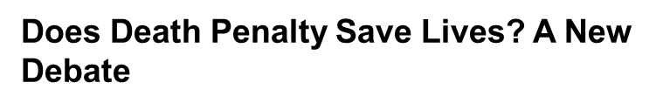
By ADAM LIPTAK
Published: November 18, 2007
For the first time in a generation, the question of whether the death penalty deters murders has captured the attention of scholars in law and economics, setting off an intense new debate about one of the central justifications for capital punishment.
According to roughly a dozen recent studies, executions save lives. For each inmate put to death, the studies say, 3 to 18 murders are prevented.
The studies, performed by economists in the past decade, compare the number of executions in different jurisdictions with homicide rates over time — while trying to eliminate the effects of crime rates, conviction rates and other factors — and say that murder rates tend to fall as executions rise. One influential study looked at 3,054 counties over two decades.
“I personally am opposed to the death penalty,” said H. Naci Mocan, an economist at Louisiana State University and an author of a study finding that each execution saves five lives. “But my research shows that there is a deterrent effect.”

Slide 71

An expert panel convened by the National Academy of Sciences concluded that existing research “is not informative about whether capital punishment decreases, increases or has no effect on homicide rates,” and that such studies “should not influence policy judgments about capital punishment.”

Slide 73
An expert panel convened by the National Academy of Sciences concluded that concluded that existing research “is not informative about whether capital punishment decreases, increases or has no effect on homicide rates,” and that such studies “should not influence policy judgments about capital punishment.”
What happened to Mocan and Gittings (2003)? Donohue and Wolfers (2005) re-examined their data…

Slide 74
t - 7
t - 1

Slide 75
Two types of coding errors were discovered. First, the authors attempted to drop all observations where the explanatory variable was the ratio of a positive value to zero but ended up both dropping the prior observation and including the variable they intended to drop, coded as the ratio of the numerator to 0.99. Second, in Models 3, 5, and 6, the execution rate was defined relative to the number of death sentences six years prior instead of seven years prior, as they did in their other specifications (and described in their text).

Slide 76
These authors examined data from 396 manuscripts submitted to the JHR during the period 2013-2018. Ninety-eight were desk rejected, 110 were rejected based on reports, and 94 were published.

Slide 77
Their Motivation
Studies have illustrated how the distribution of test statistics from published manuscripts lump at certain significance thresholds. Little is known about the underlying mechanisms driving these findings:
authors may engage in certain behavior to attain “desirable” p-values (p-hacking)
and/or the peer review process may favor statistical significance (publication bias).
This study is the first to use data from journal submissions to identify these mechanisms.

Slide 78
Their Findings
We first find that initial submissions display significant bunching [at well-known thresholds of statistical significance], suggesting prior findings cannot be strictly attributed to a bias in the peer review process
Desk rejected manuscripts display greater heaping than those sent for review, suggesting editors on average “sniff out” marginally significant results
Reviewer recommendations, on the other hand, are swayed significantly by statistical thresholds…

Slide 81
Q&A (≈ 5 minutes)

Slide 82
Section 2. Practical tips for writing your applied paper:
Sensitivity and heterogeneity analyses

Slide 83
Sensitivity Analysis
Why do a sensitivity analysis?
Reassure the reader that you’re not p-hacking
Good empirical work is transparent and easily replicated
Provide a range of estimates
Unless one particular specification is preferred, readers will expect a range of estimates
Often, theory does not dictate specification
Facilitate comparison of your estimates to those reported by previous researchers
To weight or not to weight?
Solon et al. (2015)
Unit-specific linear trends
TWFEs with staggered treatment
Reference
Solon, Gary, Steven J. Haider, and Jeffrey M. Wooldridge. 2015. “What Are We Weighting For?” JHR, 50(2): 301-316.

Slide 84
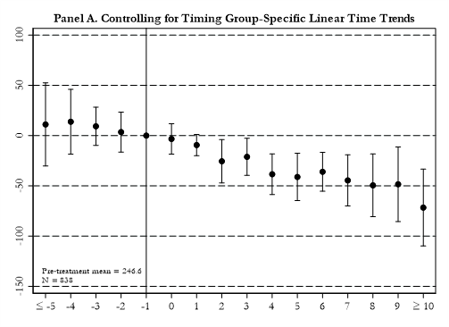

Slide 85
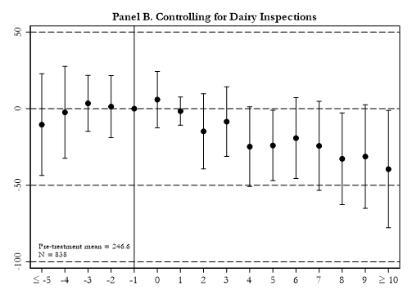

Slide 86
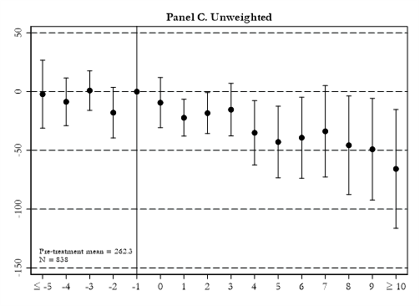

Slide 87
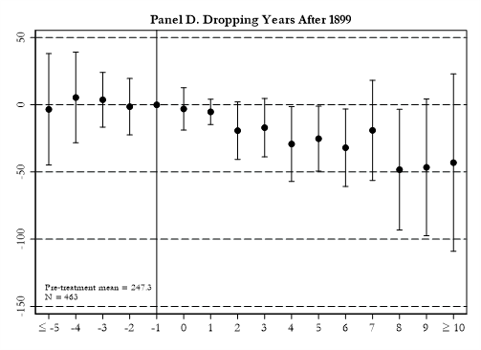

Slide 88
The goal is to be thorough without getting bogged down. It is easy to get bogged down…

Slide 89
A few more thoughts about falsification tests or adopting an alternative ID strategy
Goal
The goal is to convince the reader that your estimate is causal
Describe the threat to identification
Describing a variable as “potentially endogenous” is not enough
Describing the threat to identification sets up the falsification test or alternative ID strategy

Slide 90
Q&A (≈ 5 minutes)

Slide 91
Section 2. Practical tips for writing your applied paper:
How to write an effective conclusion

Slide 92
The Conclusion
Repeat yourself, but don’t repeat yourself!
The conclusion should contain many of the same elements found in the introduction.
But, it should be shorter and contain fewer background details.
(i) Open by again providing a general motivation
If you used some eye-catching stats as motivation in your intro, try to find some different stats for your conclusion that provide the same motivation
Consider the following example from Anderson and Sabia (2018, J of Law and Economics) who estimated the relationship between safe-storage gun laws and school shootings in the United States:
First paragraph of introduction: “School shootings, such as the recent high-profile events in Chardon, Ohio; …and Santa Fe, Texas are usually committed by students under the age of 18. In fact, between 2012 and 2015, approximately 70 percent of shootings in K-12 schools in the United States were committed by minors.”
First paragraph of conclusion: “The National Poll on Children’s Health recently indicated that 1 in 4 parents are ‘very concerned’ about school violence for their children. These fears are perhaps driven by the fact that school shootings have been reported at nearly a weekly rate since 2012.”
(ii) Reiterate the specific motivation for scholars working in this area. Remind readers of the contribution you are making to the literature.
(iii) Briefly describe your setting, data, and empirical/identification strategy but you do not have to go into as much detail as earlier
(vi) Results discussion.
This is the one place in the conclusion where I will go into more depth than in the introduction
Discuss your principal findings but do not be afraid to also remind the reader of interesting sub-analyses (e.g., heterogeneous effects, particularly convincing robustness checks, supplementary data analyses, etc.)

Slide 93
The Conclusion
The last paragraph of the conclusion is really important. Finish with a bang!
I find this to be one of the more difficult paragraphs to write in a paper. It can feel daunting, but you have options…
(i) Opine about future research
(ii) Highlight a contribution that didn’t make it into your introduction
Historical U.S. studies that relate estimates to developing countries today
“Infant Health and Later-Life Labor Market Outcomes,” Lazuka (2018, J of Human Resources)
Milk inspections paper cited earlier (Anderson et al. 2022, NBER WP No. 30063)
(iii) Policy relevance
“The Impact of Mass Shootings on Gun Policy,” Luca et al. (2020, J of Public Economics)
“Accidents Will Happen? Unintentional Childhood Injuries and the Effects of Child Care Regulations,” Currie and Hotz (2004, J of Health Economics)
(iv) List caveats to your study
Not as big a fan of this for the final paragraph. I like including caveats in the conclusion, but maybe not what you want to leave readers with as your final word.
That said, this is a common approach for the concluding paragraph and here is a nice example:
“Is Legal Pot Crippling Mexican Drug Trafficking Organisations? The Effect of Medical Marijuana Laws on U.S. Crime,” Gavrilova et al. (2017, Economic Journal)
Or some combination of (i)-(iv)

Slide 94
The Conclusion
How long should it be?
Shorter than your introduction.
The last 15 papers I have written as full-length articles for economics journals have had conclusions of the following lengths (size 12 font, double-spaced):
1-2 pages | 2-3 pages | 3+ pages
12 papers | 3 papers | 0 papers

Slide 95
Q&A (≈ 10 minutes)

